Slide 1

The Kalamazoo Route Planner Project
Client: Dustin Black
Members: Austin Miller, Bjarne Wilken, Christian Fuentes, Matthew Phillips, Mike Henke

Slide 2
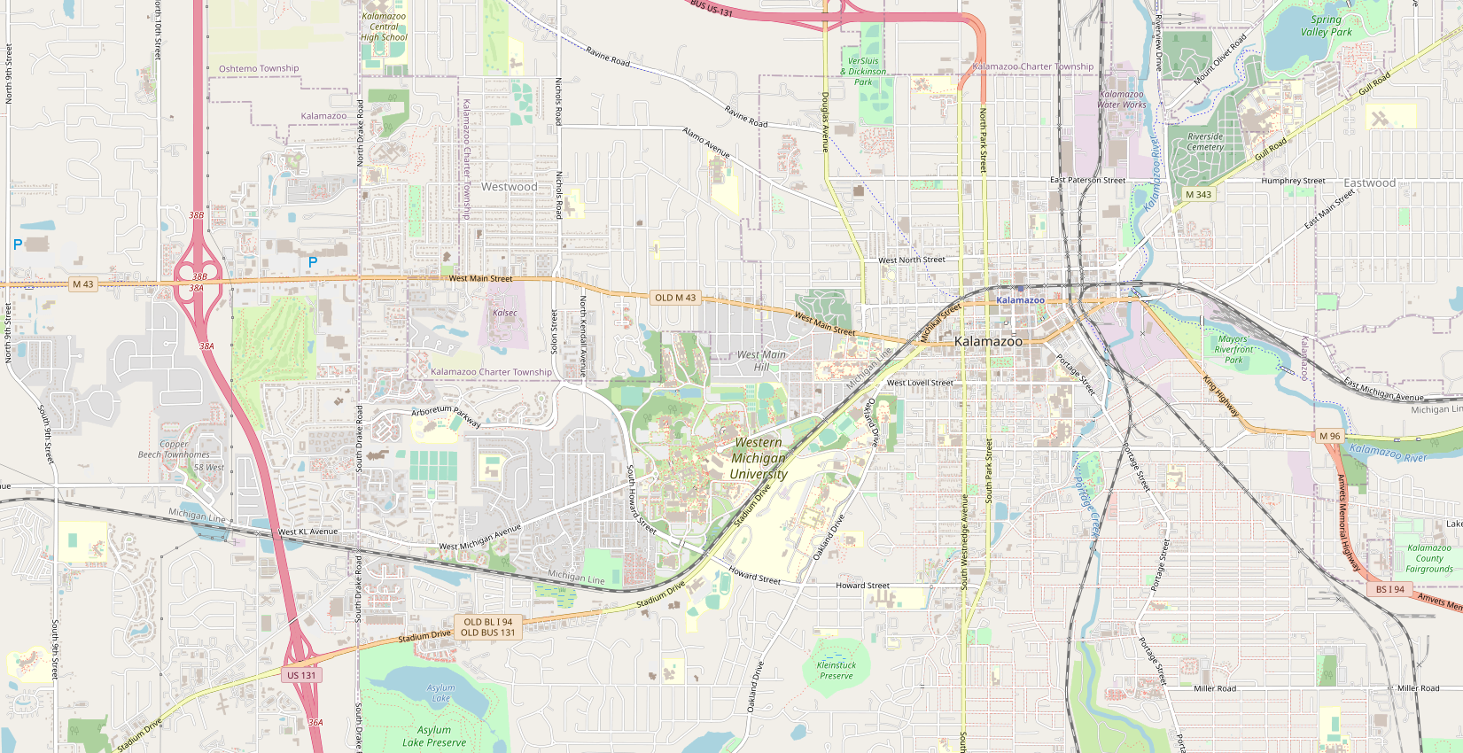
Overview oF GUI

Slide 3
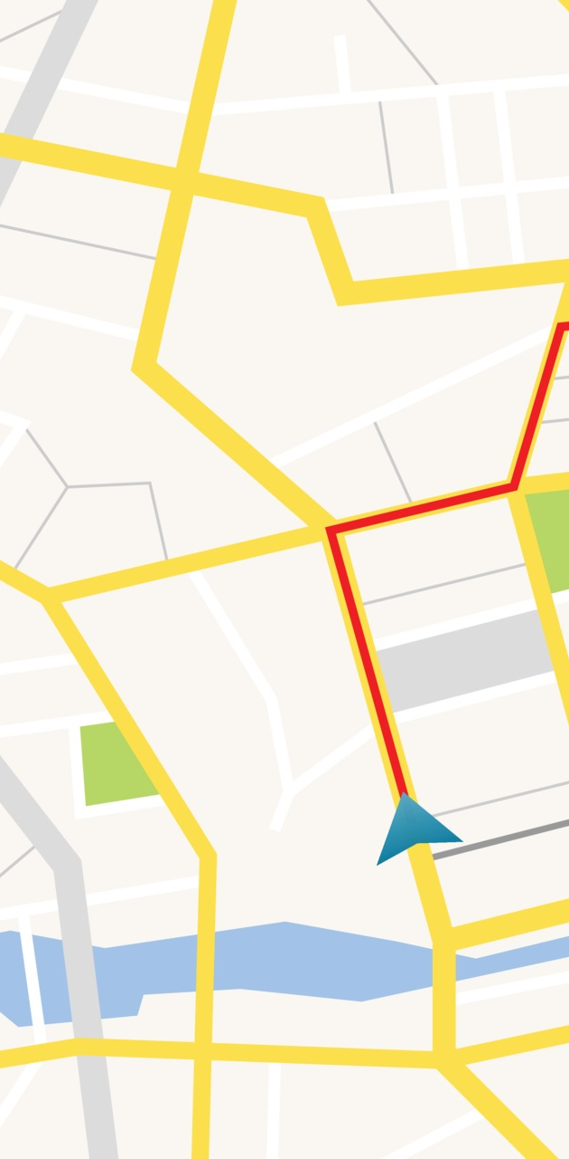
Website Overview
Fullscreen Map
Ability to add markers to the map, Max of 2
Menu Bar with many different settings that the user can enter or change.
Sliders and Buttons will be used to take in user input.
Menu Bar will also have help and about pop ups.
Layer button to change the map view from roads to satellite.

Slide 4
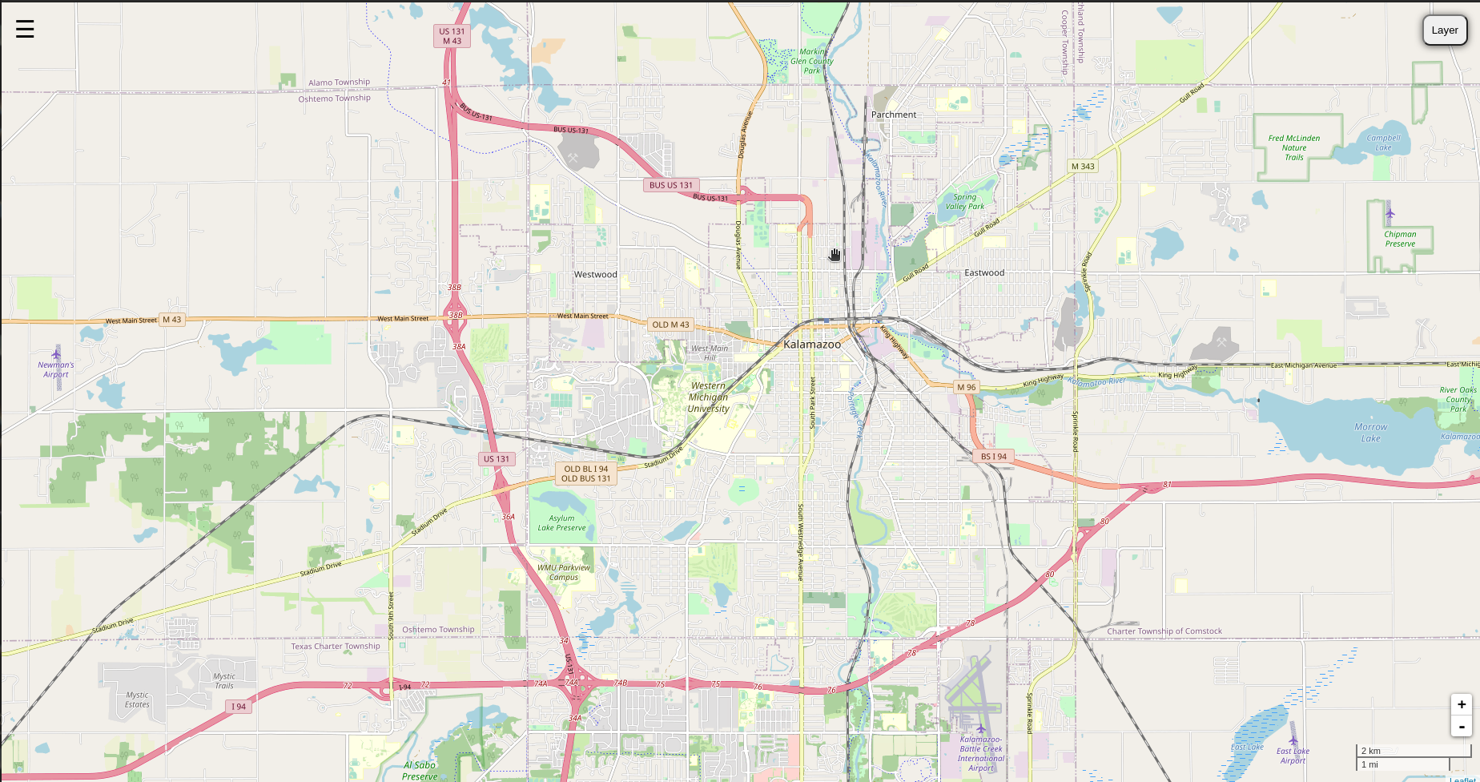
The overall website

Slide 5
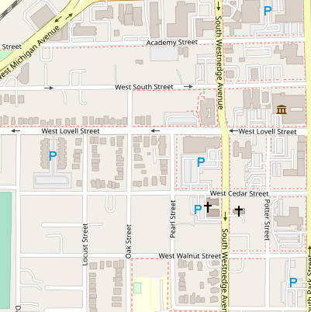
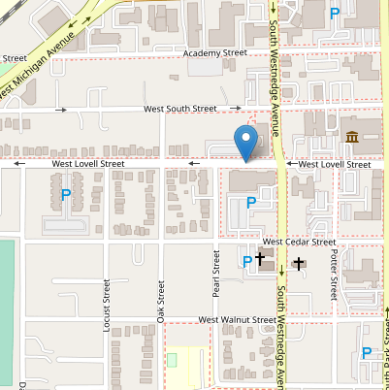
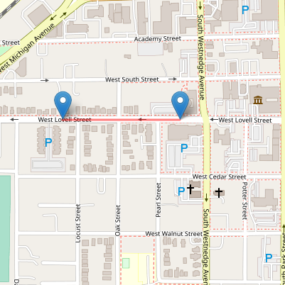
Users can place nodes and A line will be drawn between the nodes. By clicking on the map Nodes can be added and removed by clicking on them.

Slide 27

Thank you
Any Questions?

